Slide 1

Advances in Threat and Risk Information Sharing
Creating standards and a community of interest

Slide 2


Virtual Webcast
Speakers:
Cory Casanave, OMG & Model driven solutions
Gerald Beuchelt, OMG & Demandware
Facilitator
Alla Goldman, PM-ISE
The audio portion of today’s presentation is available via dial in.
United States
Toll: 1-646-307-1721
Access code: 891-727-889

Slide 3
Housekeeping Items
Recording
This webcast will be recorded and made available a few days later.
To ask a question, type it in the question panel that is located on your screen
Content questions will be answered in the order they were received at the end of the webcast

Slide 4
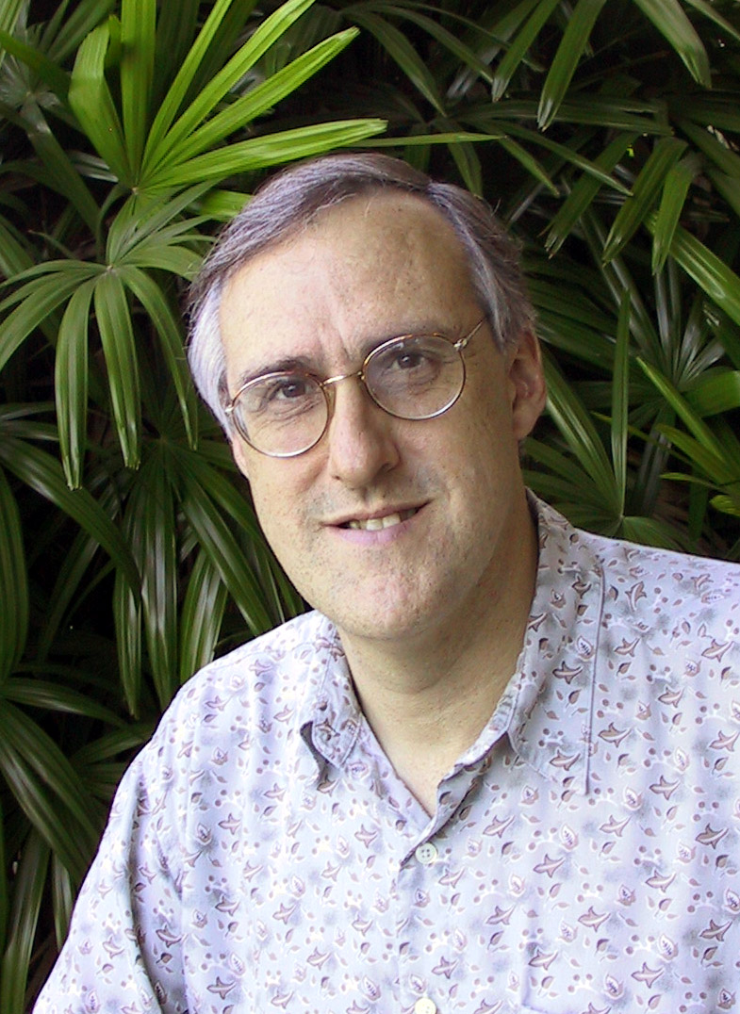
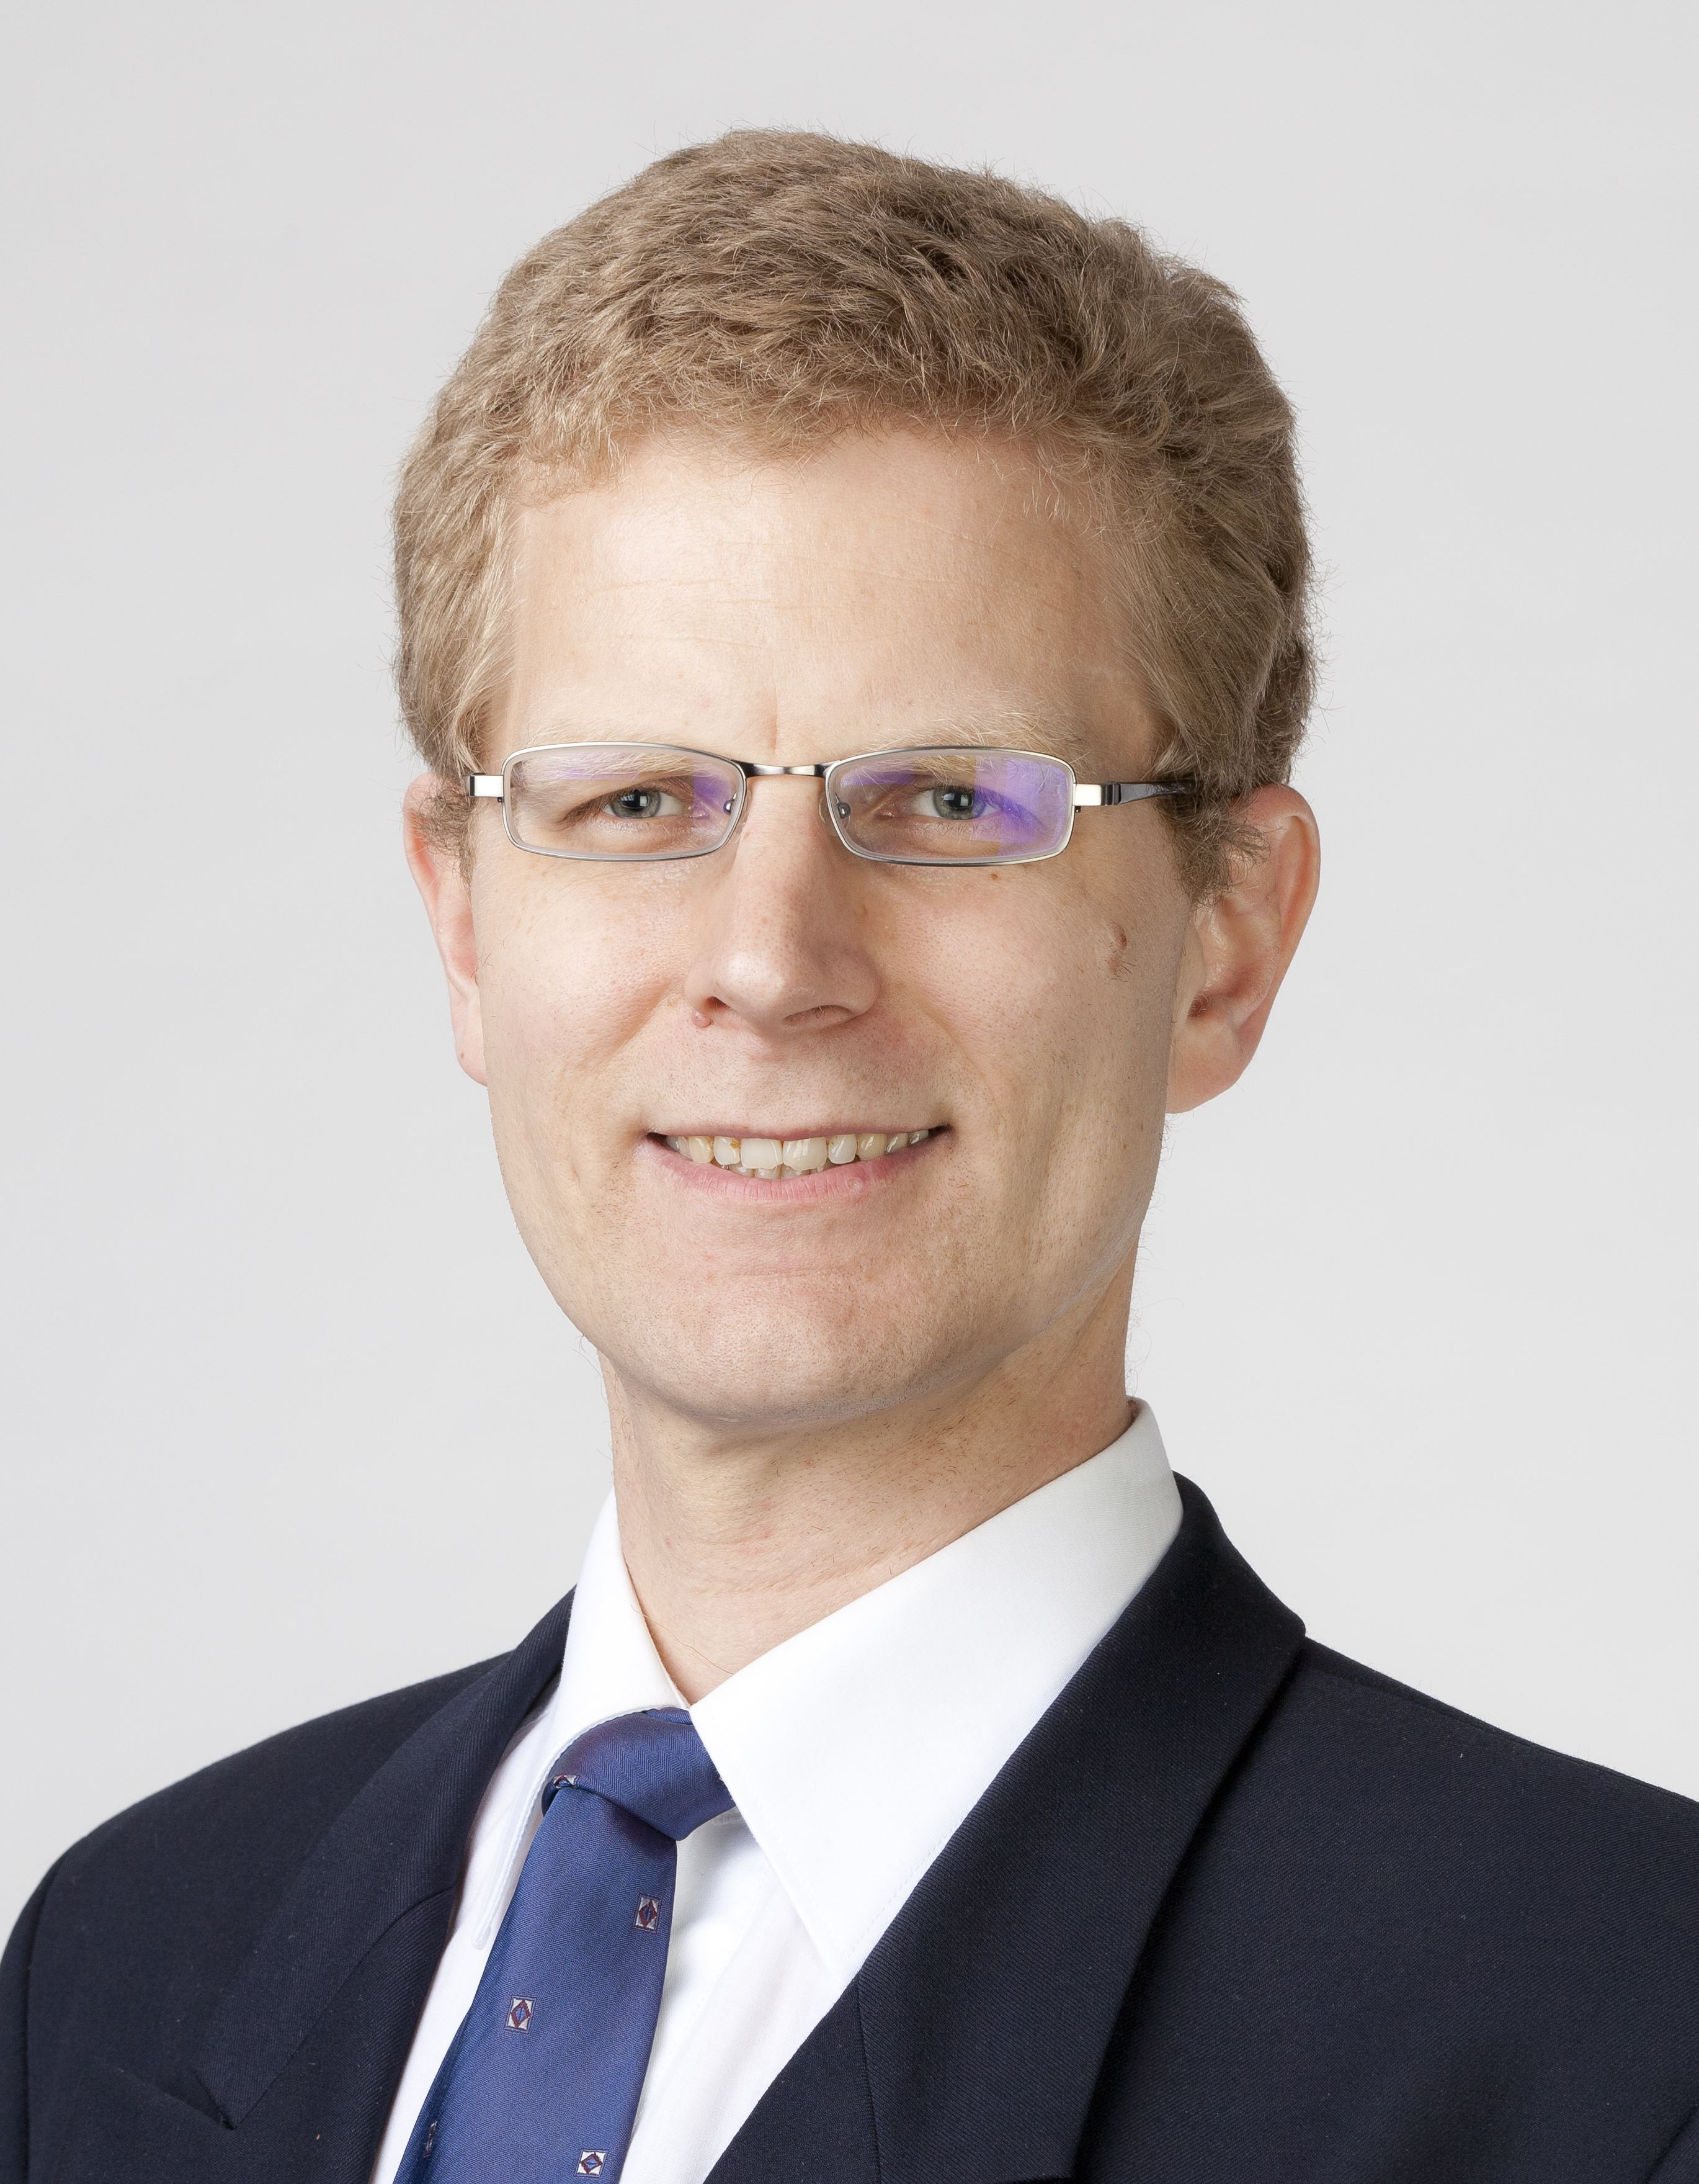

Today’s Speakers
Mr. Cory Casanave, CEO of Model Driven Solutions, representative of the Object Management Group
Mr. Gerald Beuchelt, Chief Security Officer Demandware, representative of the Object Management Group
Representative from the Program Manager for the Information Sharing Environment

Slide 5
Problem Space
There is a critical need to understand and mitigate threats and risks – to “connect the dots”.
The Landscape of threats is changing
Multiple attack vectors, cyber and other
Advanced threats utilize multiple vulnerabilities
No comprehensive consistent semantic framework
Existing systems (such as corporate GRC solutions) allow insular treatment of threat/risk relationships
Comprehensive system would allow system-of-systems interoperability (private/private, public/private)

Slide 6
We have critical needs for analytics and information sharing
Cyber
Crime
Terrorism
Critical Infrastructure
Natural
Disasters
Sharing & Analytics
Sharing & Analytics
Sharing & Analytics
Sharing & Analytics
Sharing & Analytics
Threat and risk
Identification, assessment, mitigation, situational awareness
Risks and threats from threat actors and natural sources cross domains
Yet the information sharing and analytics capabilities are stove piped

Slide 7
The Opportunity
Integrated threat and risk management across
Domains
Cyber, Criminal, Terrorism, Critical Infrastructure, Natural disasters, others…
Products and technologies
Enterprise risk management, cyber tools, disaster planning, etc…
Organizations
Government (Global, National, State, Local, Tribal), Non-governmental organizations, Commercial
Leading to
Shared awareness of threats and risks
Federated information analytics (including “big data”)
Improved mitigation of threats and risk
Situational awareness in real time
Ability to respond and recover

Slide 8
The Challenge
There are dozens of standards, exchange schema and technologies for each domain
Each uses different terminology, structure and schema to represent the same or overlapping concepts
These only work together inside of proprietary products. No one product could ever cover the entire scope
Organizations with different or multiple products can’t integrate
There is even less capability across domains
Threat actors and natural disasters don’t respect our stovepipes, they exploit them
Impact: Our capacity for coordinated mitigation and response is severely compromised

Slide 9
Primary classes of use cases
Transformation from one information sharing data format to another
Example: NIEM to a CAP Alert
Analytics of information federated from multiple sources
Example: Fusion center “connects the dots” between a stolen laptop (from NIEM) and a cyber incident (From STIX)

Slide 10
What we need is an integrating framework
Cyber
Crime
Terrorism
Critical Infrastructure
Natural
Disasters
Integrating Framework for Threats and Risks
Sharing & Analytics
Sharing & Analytics
Sharing & Analytics
Sharing & Analytics
Sharing & Analytics
An integrating framework that helps us deal with all aspects of a risk or incident
A federation of risk and threat information sharing and analytics capabilities

Slide 11

It takes a community
Threat & Risk Information
Sharing Community
Leadership
Information
Sources
Policy
Standards
Tools &
Services
Information Analysts
& Consumers

Slide 12
Program Manager for the Information Sharing Environment
Our Focus
Advance responsible information sharing to further counterterrorism, homeland security, and cybersecurity missions
Improve nationwide decision making through information sharing
Promote partnerships across federal, state, local, and tribal governments, the private sector, and internationally
Visit ISE.gov
Project Interoperability
http://project-interoperability.github.io/

Slide 13
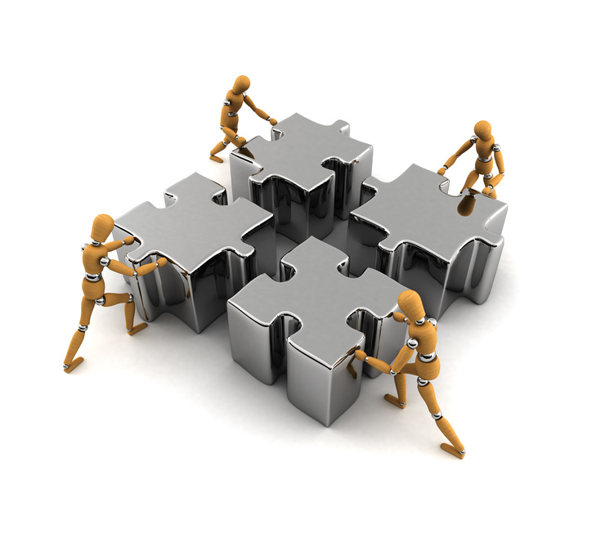
Call to action!
This is a call to action
Form a threat/risk information sharing community of interest
Engage in and support the OMG standards effort
Identify & engage
Vendors
Users
Information sources
Use cases
Pilot projects
Existing standards/schema

Slide 14
Example Scenario

Slide 15
Example Scenario: Coordinated Power Grid Attack
Attack
Laptop with access credentials is stolen
Grid industrial control system is compromised in Cyber attack
Physical attack on substation disrupts power
Compromised system cascades failure
Physical infrastructure damaged
Potential Mitigations
Law enforcement recovers laptop
Compromise is recognized by Cyber defense, system is hardened
Law enforcement notified and arrests attackers
Preparation is identified and defense forces put in place
Real-time notification of systems going down initiates manual shutdown

Slide 16



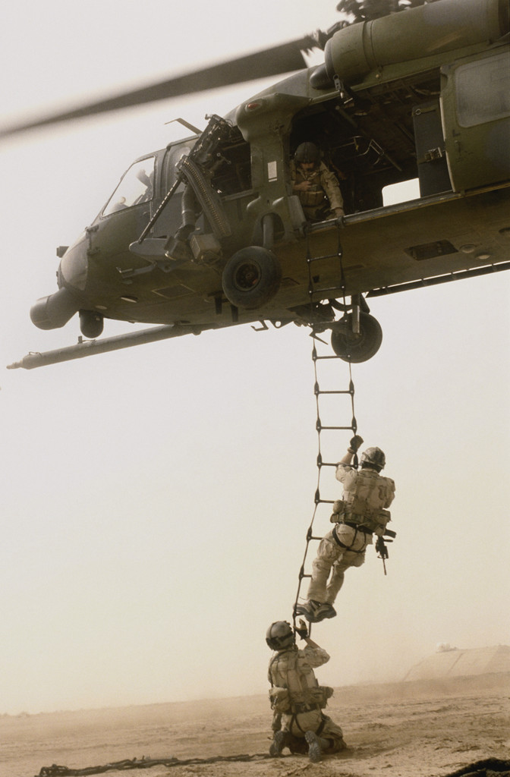



Potential Information Flows
Suspicious Activity Report
NIEM
Incident
Arrest Report
STIX Incident
Tactical Response Unit
Fusion Center
Intelligence
Report
IT System Hardening
Manual Shutdown
Public CAP Warning

Slide 17
Bridging Experience Domains with common concepts
Common Concepts
What is the current context
What is happening
What is vulnerable
What is the impact
Who is impacted
Who is doing this
What can we do
What are we doing
Who should know
How they are used
Data elements in multiple schema are mapped to the underlying concepts
Bridge technologies enable cross-domain, cross-organizational and cross-technology information sharing

Slide 18
Example Use Case: Large Company
Company with multiple datacenters, office facilities, international business activity
Large number of deployed security systems, sensors
Firewalls, IDS/IPS, SIEM, monitoring systems, notification/alerting, etc.
Uses FW/Snort rules, STIX/TAXII, IODef, alarms for fire and intrusions, etc.
Physical and information security staff, some 24/7
Interoperable (but not uniform) threat monitoring and assessment

Slide 19
OMG Standards Process
Operational Threat and Risk RFP Process

Slide 20
OMG Process
The operational risk/threat RFP has been issued by the Object Management Group
http://www.omg.org/cgi-bin/doc.cgi?sysa/2014-6-17
While there may be multiple submissions to an RFP, the submission team is currently unified and has a working site
https://github.com/omg-threat-modeling/phase1/
The submission team is open and invites collaborators
The final submission is due August 2015 but substantial assets will be developed sooner

Slide 21
Precepts
The purpose/organizational/technology specific schema will not (should not) go away
A “one size fits all” solution will not work
There will be no one technology
There will be no one terminology or language
There will be no one data structure for threats and risks
Our focus is federation
Understanding the concepts behind the schema
Mapping them to/through a common conceptual model
Enabling interoperability by bridging between the specific schema
Supporting integration and coordination of mitigation and response capabilities

Slide 22
Scope
The RFP calls for a conceptual model for operational threats and risks that unifies the semantics of and can provide a bridge across multiple threat and risk schema and interfaces. The conceptual model will be informed by high-level concepts as defined by the Cyber domain, existing NIEM domains and other applicable domains, but is not specific to those domains. This will enable combined Cyber, physical, criminal and natural threats and risks to be federated, understood and responded to effectively.
Out of scope for this RFP is non-operational business relevant risk such as marketplace risk, credit risk, legal risk, project management risk, etc.
The conceptual model will have an explicit mapping to NIEM and STIX. Other exchange formats, such as CAP may be supported as well.

Slide 23
Typical Threat/Risk Concepts To Define
Operational Threat
Operational Risk
Asset
Campaign
Cause
Effect
Exploit target
Goal
Hazard
Impact
Incident
Indicator
Likelihood
Mitigation
Observable
Observation
Observation Metadata
Procedures
Risk
Safeguard
Severity
Strategy
Tactics
Techniques
Threat
Threat actor
Threat source
Undesired event
Note: List not exhaustive.

Slide 24
Foundations
STIX/TAXII used for indicator of compromise (IOC) sharing and some limited modeling adjacent to the cyber domain
Oasis EDXL – Emergency management domain
NIEM in law enforcement
Other “cyber” initiatives (e.g. IODef, Yara, Snort, etc.) are getting beyond their traditional boundaries

Slide 25
Scope Diagram
Wide & shallow conceptual model generically covering threats and risks
Other risks (Out of scope)
Operational Threat & Risk Concepts
High level Cyber-threat/risk concepts
Law Enforcement / Emergency Management Concepts
Physical. Spectrum, facilities,
Probabilities, Forensic, Chemical, Biological, Medical, Nuclear, Military and Intelligence threats concepts
STIX/TAXII/Cybox
IODEF
SACM
ISO
NIST
Others…
NIEM Threat/Risk Representation
Other Risks
Systemic Risk
Credit Risk
Market Risk
Pension Risk
Reputation Risk
Liquidity Risk
Legal Risk
Project Management Risk
Legend
Normative
(Formal Specification)
NIEM Exchanges
EDXL / CAP
Others…
Other Inputs
In Scope with Limited Detail
Informative

Slide 26
Submission Team Progress
A team has formed and has resources from both industry and government sources with a collaboration site, regular meetings and email list
UML models of several informative models have been produced
STIX, NIEM, CAP, ISO 072-2009, Business Motivation
Foundational conceptual models have been developed
Mechanisms for UML based mapping are in prototype (leverages SIMF effort)
Mappings between the conceptual model are started for
STIX
NIEM
Outreach campaign initiated (industry conferences, vendors, standards organizations and government agencies)

Slide 27
Approach

Slide 28
Approach
Highlight O(N) vs. O(N^2)
Construct a conceptual model informed by existing schema, research and best practices
This conceptual model is independent of specific data structures, technologies and terminologies
Define mapping models between the conceptual model and purpose/organizational schema
Make both models sufficiently precise that they can drive automated bridging between any mapped schema
Cyber
Terrorism
Cyber
Cyber
Cyber
Disasters
Map/Bridge
Map/Bridge
Map/Bridge
Conceptual Model
Map/Bridge
Map/Bridge
Criminal
Cyber
Criminal
Infrastructure

Slide 29
Core Concept: Comprehending Planned and Unplanned Threats
“All hazards” include man-made and natural disasters/system failures
There is not always an actor involved (e.g. hurricane, system malfunction)
Intentional threat actors are not the only source of threats
Non-malicious actors may constitute significant threat (e.g. spear-phishing victim, power plant operator)
Defenders (e.g. system admins, law enforcement, medical staff) are also actors with defensive plans
Victims are actors as well

Slide 30

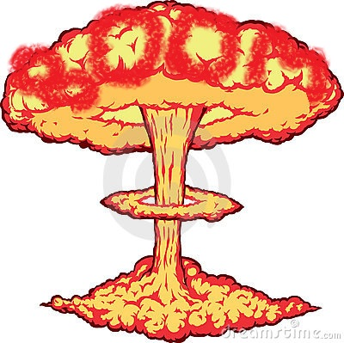


Intent
Threat Actor
Plan
Capability
Act
Potential Effect
Real World Effect
Vulnerability
Risk
Threat
Incident
Consequence
Impact on Objectives
Stakeholder
Potential Event
Actual Event
Natural event or System failure

Slide 31
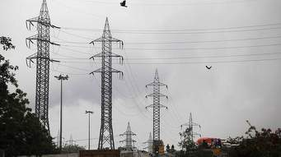
Core Concept: Attacker/Defender Symmetry
Attack perspective:
Defender: Attackers/hazards are threats
Attacker: Targets are opportunities
Defense perspective:
Attacker: Successful defense is a threat to the intentions/objectives
Defender: Maintaining effective defensive posture is an opportunity
Threat vs. Opportunity is in the eye of the emoticon – it is not sufficient to create static classifications
Opportunity!
Capability to disrupt the power grid
Threat!
Notes:
One mans risk is another mans opportunity
The same risk/threat/incident needs to be understood from very different perspectives
Classifying something as a risk/threat/incident or mitigation only makes sense with respect to how it impacts the objectives of some stakeholder. E.g “a risk of damage to the U.S. power grid impacting millions”.
The conceptual model supports this separation while mapping to structures that assume a particular perspective.

Slide 32
Core Concept: Actor Capabilities
Limiting actors to a static or single role in a specific scenarios is not helpful
Defensive actors may use offensive actions and plans to achieve defense objectives
Attackers may use defensive actions for ensuring OPSEC for the plan
Bystanders may support defensive or offensive plans or actions
Capabilities actors
Capabilities may include offensive, defensive, and other abilities
Actors can leverage capabilities in executing plans
We can categorize actors and events in multiple ways

Slide 33
Model Details
Examples of specific risk/threat concepts – intended to show how the conceptual model is being produced

Slide 34
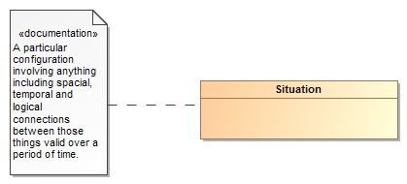
Threats and Risks of What?
A threat or risk is with respect to some undesirable situation
What is a situation?
We define a situation as a configuration of things…
People places, things, events, occurrences and the connections between them.
Some situations are consequences of others
Situations provide a link between different kinds and phases of threats & risks

Slide 35
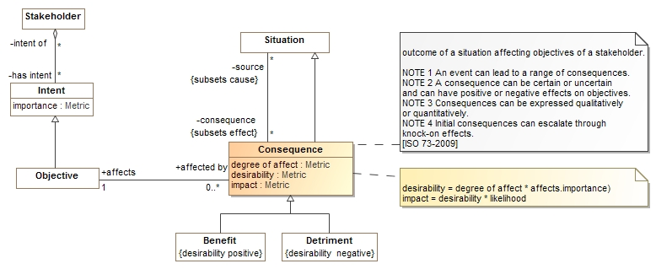
Consequences
Situations may have consequences (an effect of the situation)
Consequence can be positive or negative: benefits or detriments, respectively
Consequences affect the objectives of stakeholders
This leads to the desirability of the consequence (positive or negative)
Desirability * likelihood provide the impact (→risk metric for detriments)

Slide 36
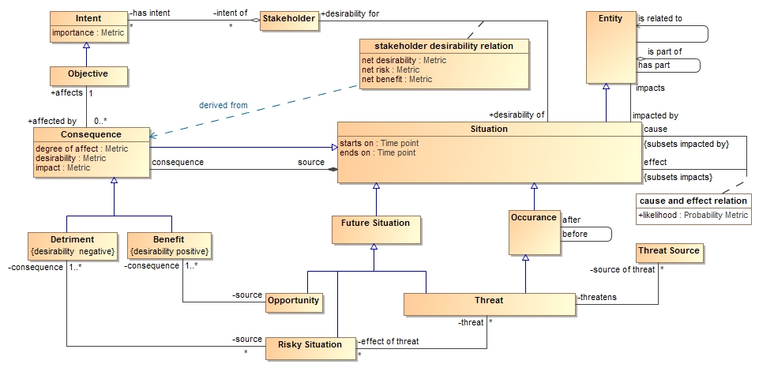
Core Risk/Threat Concepts

Slide 37
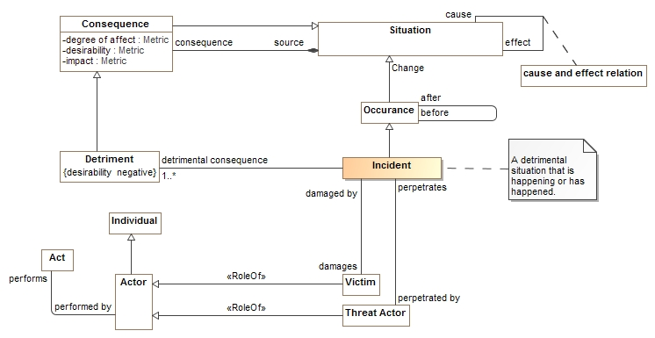
Incidents

Slide 38
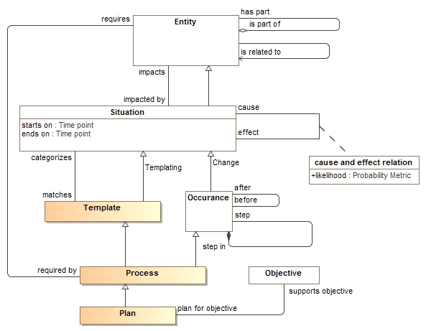
Processes and plans

Slide 39
Mapping example
Transformation from one information sharing data format (STIX) to another (NIEM)

Slide 40
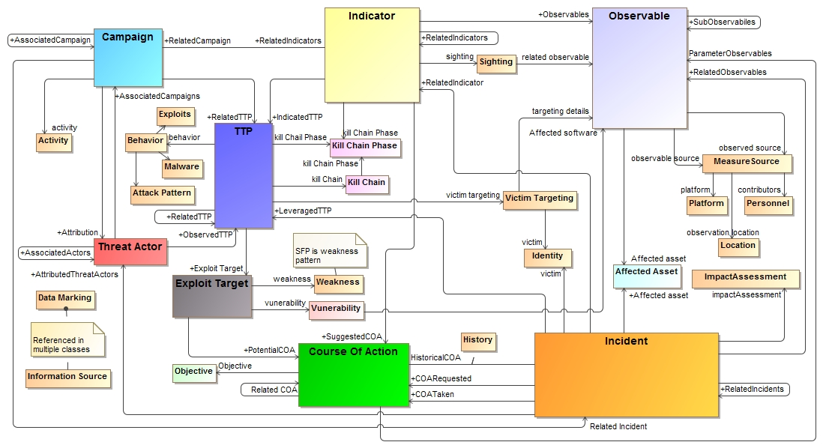
STIX (High Level) in UML

Slide 41
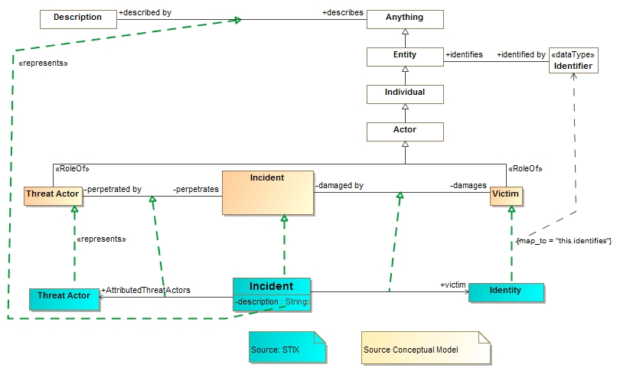
STIX Mapping fragment
Note: Complete mapping rules are more complex

Slide 42
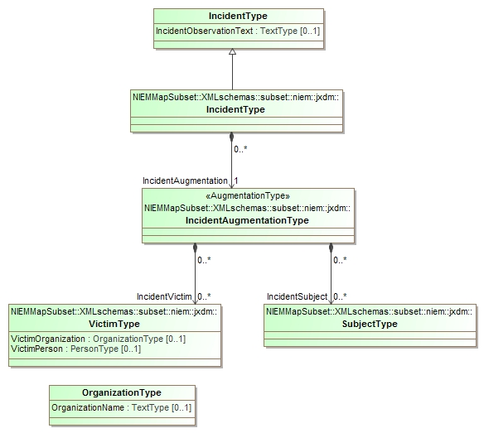
Corresponding NIEM Subset of interest
Multiple classes representing an incident due to the way NIEM segments domains

Slide 43
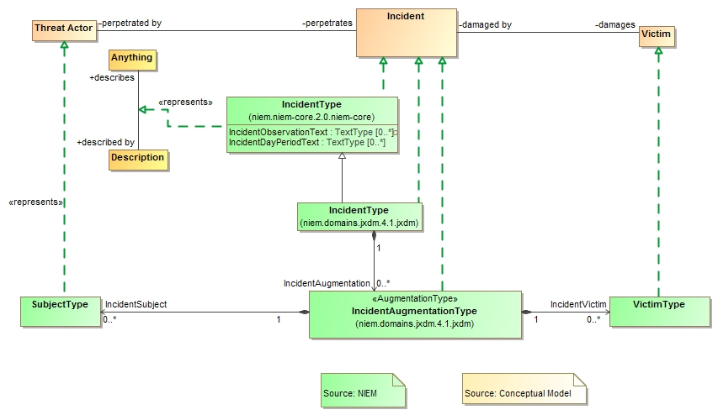
NIEM Mapping Fragment

Slide 44
Example STIX data
<stix:Incident id="example:incident-fd56fb34-af59-47b3-95cf-7baaaa53fe93" timestamp="2014-08-28T16:42:52.859547+00:00" xsi:type='incident:IncidentType' version="1.1.1">
<incident:Title>Breach of Canary Corp</incident:Title>
<incident:Time>
<incident:Incident_Discovery precision="second">2013-01-13T00:00:00</incident:Incident_Discovery>
</incident:Time>
<incident:Description>Intrusion into enterprise network</incident:Description>
<incident:Reporter>
<stixCommon:Description>The person who reported it</stixCommon:Description>
<stixCommon:Identity id="example:Identity-5db269cf-e603-4df9-ae8c-51ff295abfaa">
<stixCommon:Name>Sample Investigations, LLC</stixCommon:Name>
</stixCommon:Identity>
<stixCommon:Time>
<cyboxCommon:Produced_Time>2014-03-11T00:00:00</cyboxCommon:Produced_Time>
</stixCommon:Time>
</incident:Reporter>
<incident:Victim id="example:Identity-c85082f3-bc04-43c8-a000-e0c1d0f2c045">
<stixCommon:Name>Canary Corp</stixCommon:Name>
</incident:Victim>
<incident:Impact_Assessment>
<incident:Effects>
<incident:Effect xsi:type="stixVocabs:IncidentEffectVocab-1.0">Financial Loss</incident:Effect>
</incident:Effects>
</incident:Impact_Assessment>
<incident:Confidence timestamp="2014-08-28T16:42:52.859570+00:00">
<stixCommon:Value xsi:type="stixVocabs:HighMediumLowVocab-1.0">High</stixCommon:Value>
</incident:Confidence>
</stix:Incident>

Slide 45
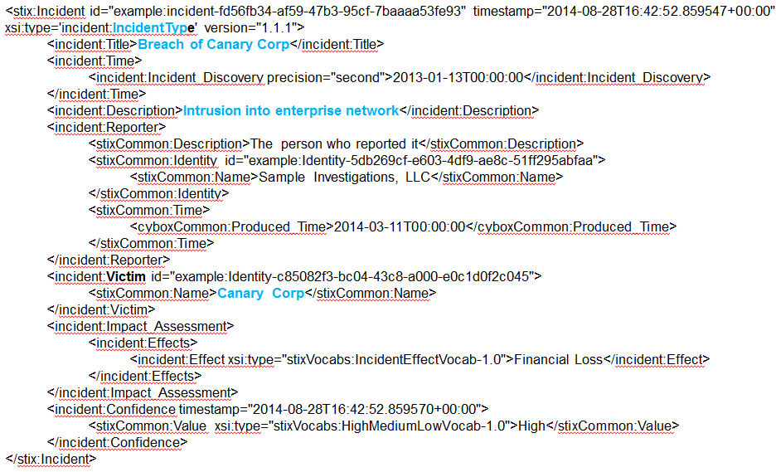
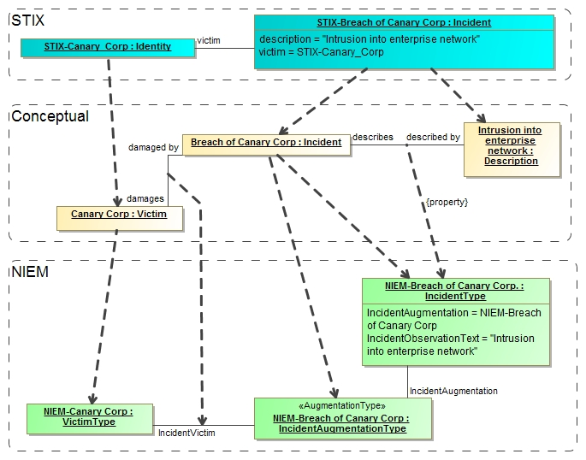
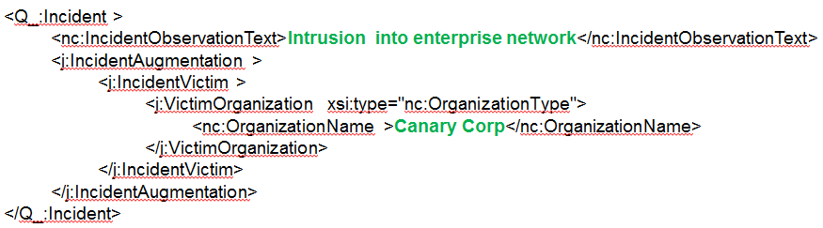
Notional Model Mapping Instances
STIX Data
Note: Conceptual instances are “virtual”, no actual instances are necessarily created.
NIEM Data

Slide 46
Derived NIEM Data
<Q_:Incident >
<nc:IncidentObservationText>Intrusion into enterprise network</nc:IncidentObservationText>
<j:IncidentAugmentation >
<j:IncidentVictim >
<j:VictimOrganization xsi:type="nc:OrganizationType">
<nc:OrganizationName>Canary Corp</nc:OrganizationName>
</j:VictimOrganization>
</j:IncidentVictim>
</j:IncidentAugmentation>
</Q_:Incident>
Note that only elements of interest that have a correspondence between STIX and NIEM are mapped. However, this kind of summary may be what is needed by, for example, law enforcement.

Slide 47
Outlook

Slide 48
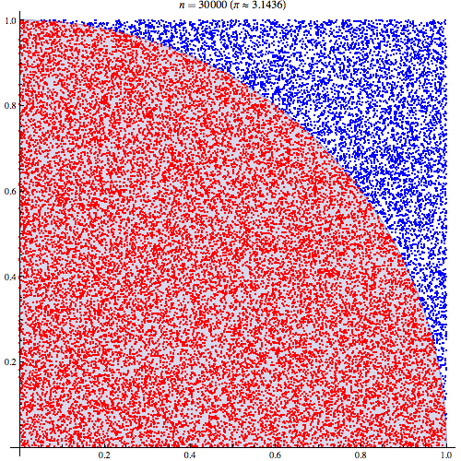
Additional Applications
People
Technology
Governance
Risk
Compliance
Operations
Enterprise Risk Modeling
Cross-domain accounting for threats, vulnerabilities, and risk
Tighter integration with public information sources
Modeling for Response Strategies
Parameterization of threat and risk landscape
Monte-Carlo simulation and response testing
Real time situation awareness
Analytics
"Pi 30K" by CaitlinJo - Own workThis mathematical image was created with Mathematica. Licensed under Creative Commons Attribution 3.0 via Wikimedia Commons

Slide 49
Conclusions
Current logical models are application domain specific or domain centric
Focus on emergency management, cyber/INFOSEC, law enforcement, etc.
Interoperability between different systems is hard and manual
No comprehensive threat pictures that includes an “all-hazards” view
Conceptual models with mappings can aid this by providing semantic glue to allow effective mapping
Call to Action: Engage with “Team Threat & Risk”

Slide 50
Questions and Answers

